Slide 1


Slide 2

No Rest till gRpc!

Slide 3

When it comes to communication, most coders have clear preferences:
But we got alternatives, like signalr, message queues, or...

Slide 4
"A high performance, open-source universal RPC framework
G(?)
R(emote)
P(rocedure)
C(all)

Slide 5
Grpc... - uses binary messages formatted by protocol buffers - must be strictly contract compliant - is platform-independent - is Http2 based - is secure by default (https only!) - can be used for both unary and stream requests, also bi-directional

Slide 6
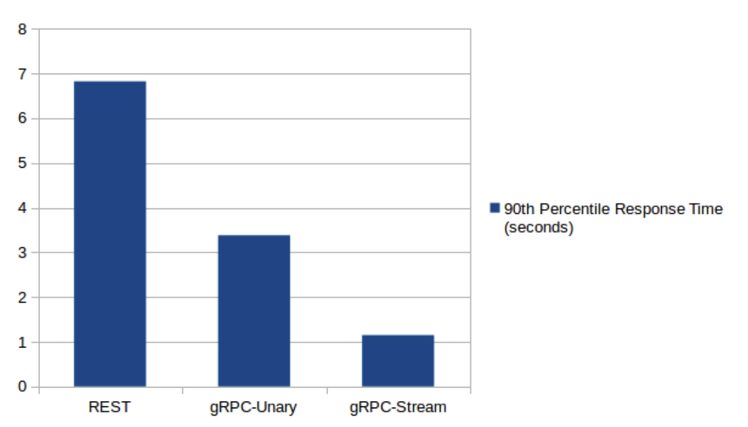
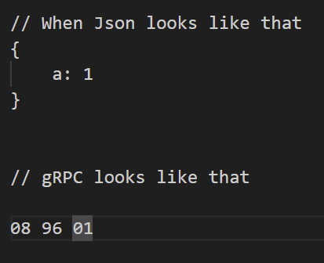
http 2 gprc vs http 1.1 rest api – speed and message forms

Slide 7
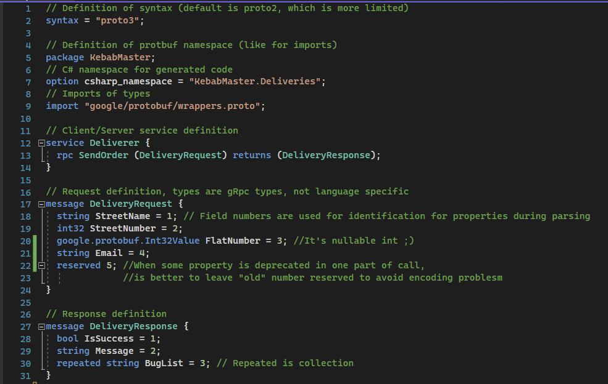
Grpc uses protocol buffers, which is schema language for message encoding and validating contracts

Slide 8
Security
Grpc, uses standard http-based security mechanisms, like certifications and tokens, so
security-wise it is easy to migrate to it from rest

Slide 9
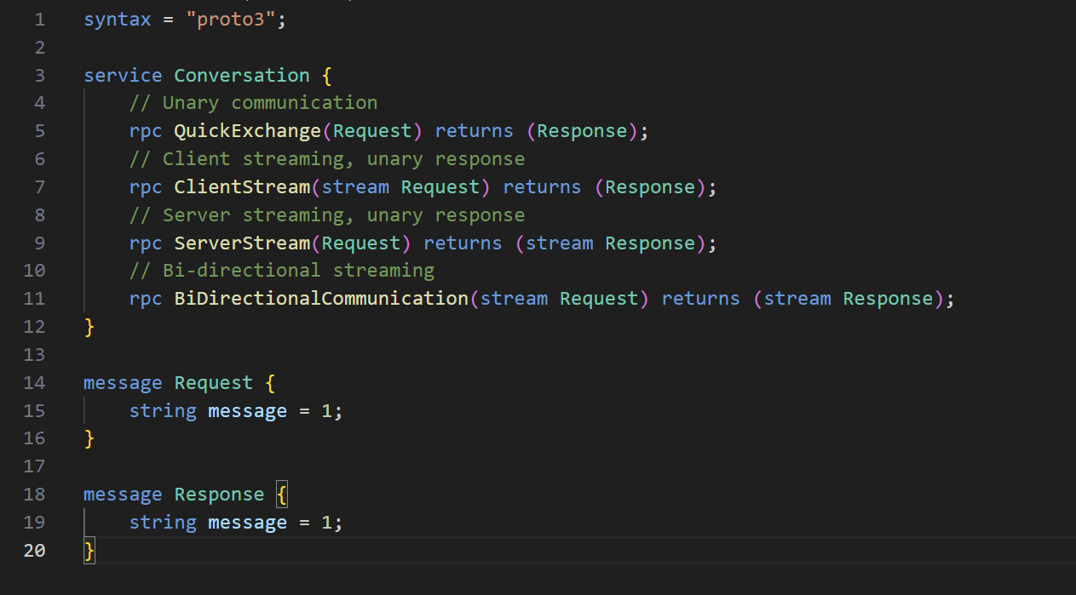
Grpc uses unary and stream-based communication and defining it in protocol buffers is really easy

Slide 10

Demo!
capgemini.com

Slide 11
Disadvantages:
Disadvanatages of grpc boil down to steeper learning curve and more tools needed to use it (browser won’t suffice)
Average grpc fan doing the same thing:
Average Rest enjoyer explaining to client how to make get request:

Slide 12
Usage – in short
-Rest
Better for human – service communication
-grpc
Better for service-service communication

Slide 13
Questions?
capgemini.com

Slide 14
Next topic: Net 8 – what’s new? by michał bryłka and leszek kowalski! Stay tuned!
Thanks everyone!
capgemini.com

